Slide 1


Object-Oriented Programming Using C++
Third Edition
Chapter 7
Using Classes

Slide 2
Objectives
Create classes
Learn about encapsulating class components
Implement class functions
Use private functions and public data
Use the scope resolution operator with class fields and functions
Use static class members
Learn about the this pointer
Understand the advantages of polymorphism

Slide 3
Creating Classes
A class is a category of objects; it is a new data type
  Classes provide a description of an object
  Classes provide a convenient way to group related data and the functions that use the data
  When you create an object from the class, you automatically create all the related fields
  You think about them and manipulate them as real-life classes and objects
Abstract data type (ADT): a type that you define

Slide 4
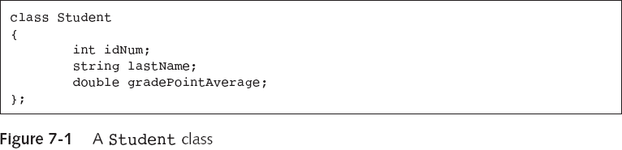
Creating Classes (continued)
Student aSophomore;
aSophomore.idNum = 7645;
cout<<aSophomore.idNum;
Error! By default, all members of a class are private

Slide 5
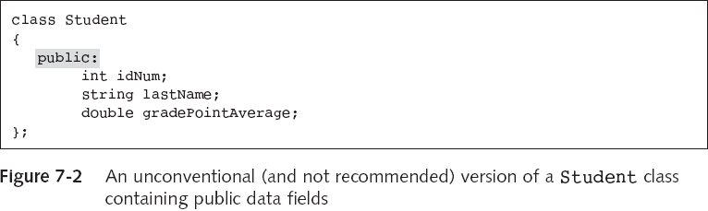
Creating Classes (continued)
Access modifier

Slide 6
Encapsulating Class Components
To encapsulate components is to contain them
  Encapsulation is an example of a black box
An interface intercedes between you and the inner workings of an object

Slide 7
Designing Classes
If you need a class for students, you should ask:
  What shall we call it?
  What are its attributes?
  What methods are needed by Student?
  Any other methods?
In most cases, you declare both fields and functions
  You declare a field using a data type and an identifier
  You declare a function by writing its prototype, which serves as the interface to the function

Slide 8
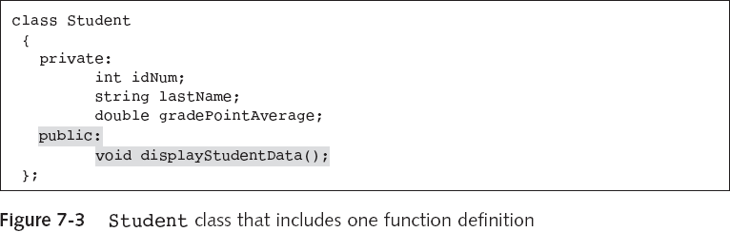
Designing Classes
To instantiate an object is to declare or create it
  Student aSophomore;
  aSophomore.displayStudentData();
A function that uses your class is a class client

Slide 9
Implementing Class Functions
When you construct a class, you create two parts:
  Declaration section: contains the class name, variables (attributes), and function prototypes
  Implementation section: contains the functions
Use both the class name and the scope resolution operator (::) when you implement a class function

Slide 10
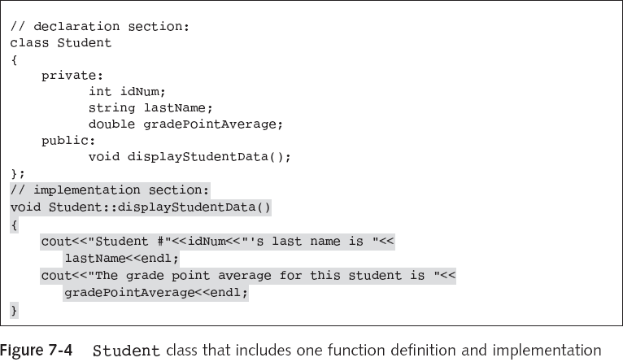
Implementing Class Functions (continued)

Slide 11
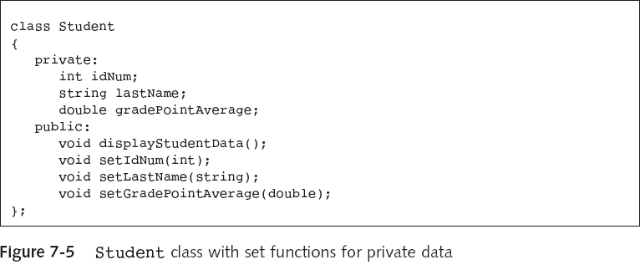
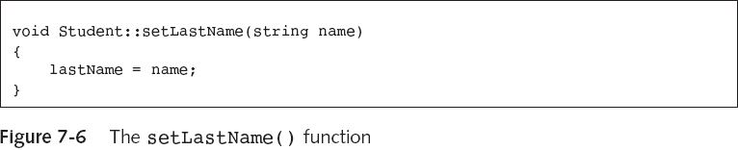
Using Public Functions to Alter Private Data

Slide 12
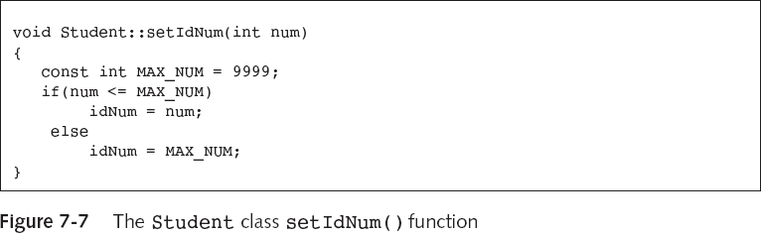
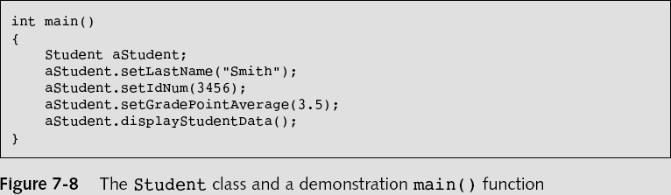
Using Public Functions to Alter Private Data (continued)
…

Slide 13
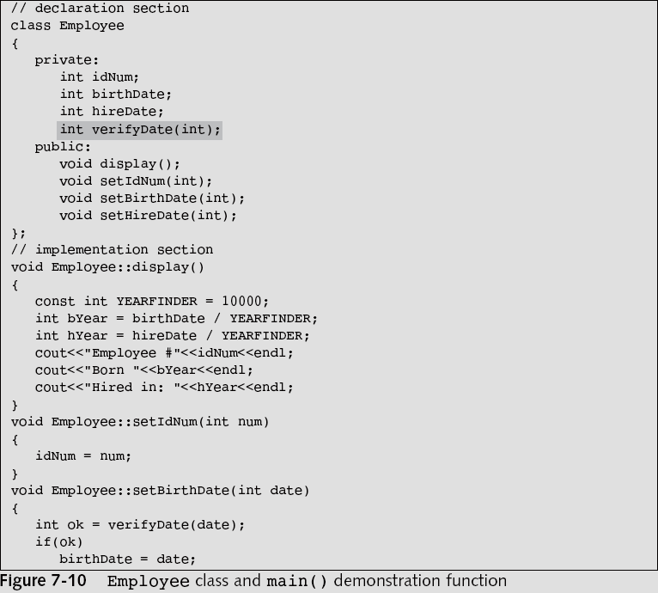
Using Private Functions and Public Data

Slide 14
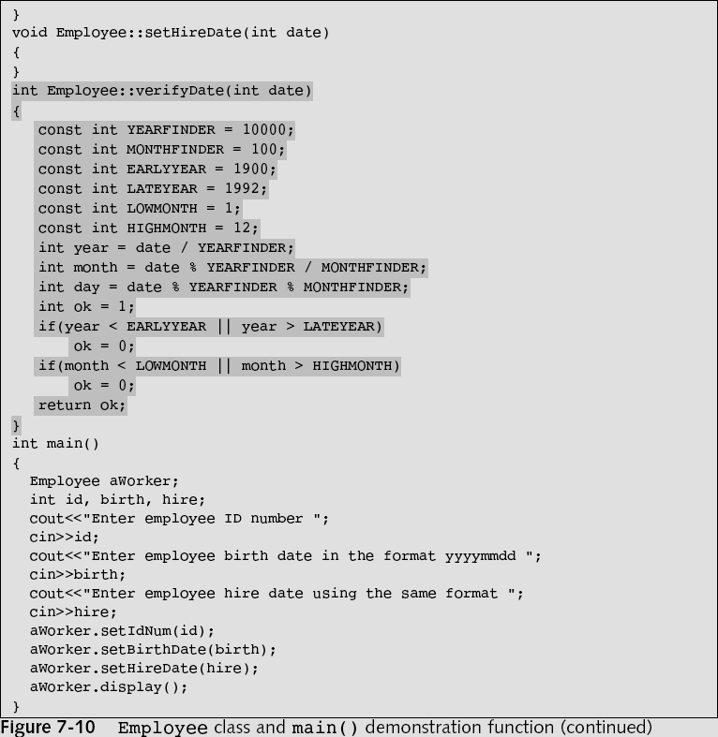
…
…

Slide 15
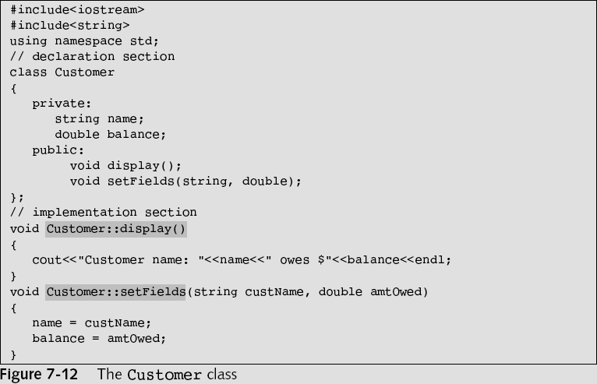
Considering Scope when Defining Member Functions

Slide 16
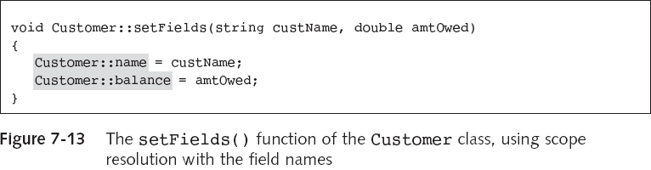
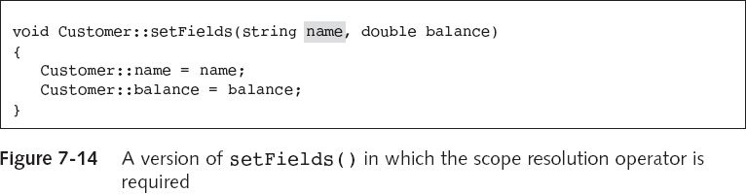
Considering Scope when Defining Member Functions (continued)

Slide 17
Using Static Class Members
When a class field is static, only one memory location is allocated
  All members of the class share a single storage location for a static data member of that same class
When you create a non-static variable within a function, a new variable is created every time you call that function
When you create a static variable, the variable maintains its memory address and previous value for the life of the program

Slide 18
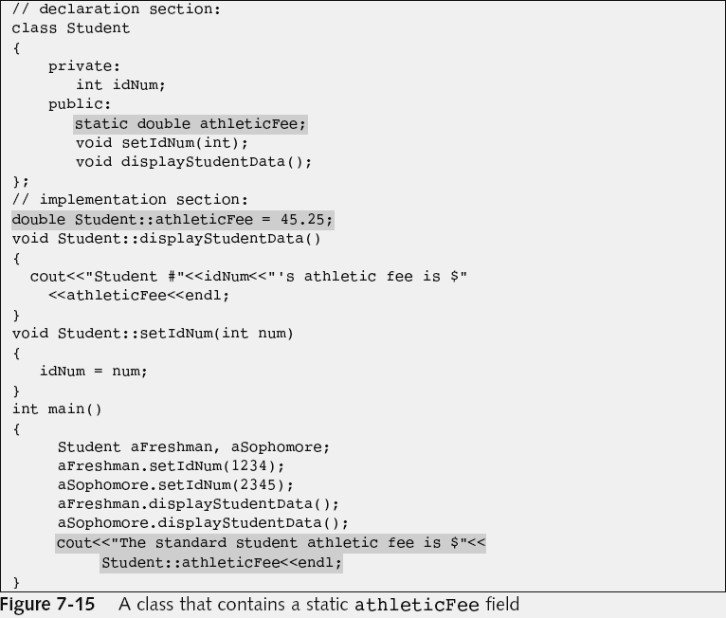
Defining Static Data Members
Since it is not const, anyone can modify it

Slide 19
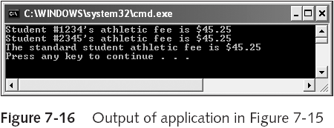
Defining Static Data Members (continued)
Static variables are sometimes called class variables, class fields, or class-wide fields because they don’t belong to a specific object; they belong to the class

Slide 20
Using Static Functions
A static function can be used without a declared object
Non-static functions can access static variables (provided there is an object)
Static functions cannot access non-static variables

Slide 21
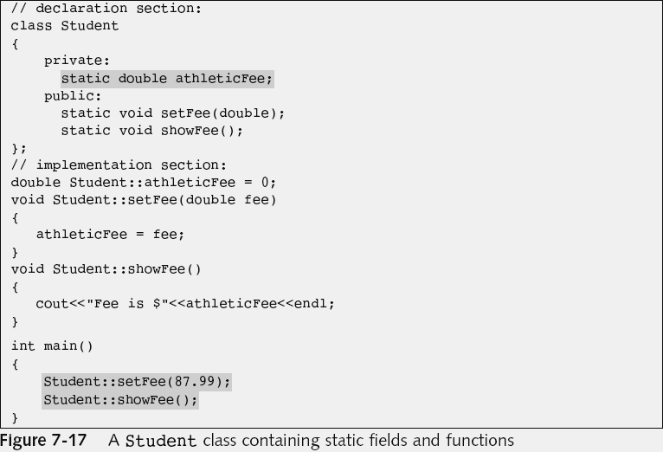
Using Static Functions (continued)

Slide 22
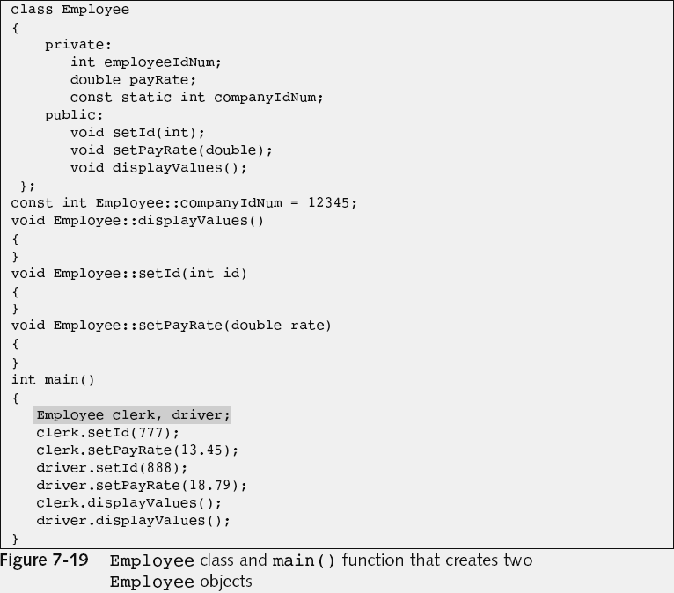
Understanding the this Pointer
…
…
…

Slide 23
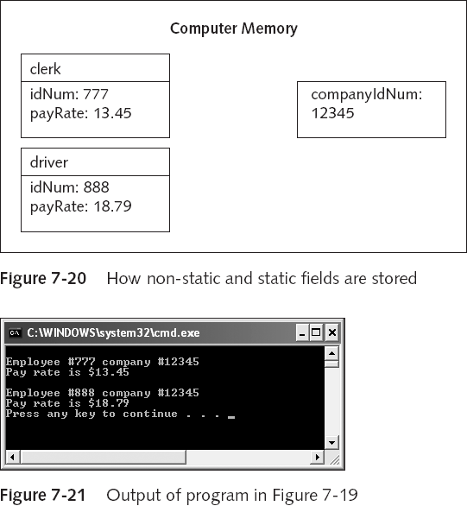
Understanding the this Pointer (continued)

Slide 24
Understanding the this Pointer (continued)
The this pointer holds the memory address of the current object that is using the function
The this pointer is automatically supplied when you call a non-static member function of a class
  For example, clerk.displayValues();
  Is actually displayValues(&clerk);
The actual argument list used by the compiler for displayValues() is displayValues(Employee *this)
The this pointer is a constant pointer

Slide 25
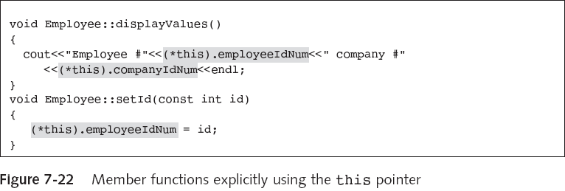
Using the this Pointer Explicitly

Slide 26
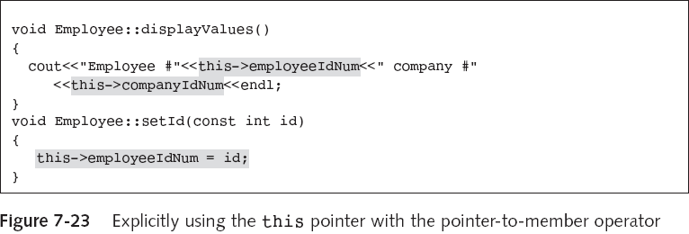
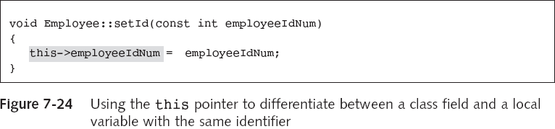
Using the Pointer-to-Member Operator

Slide 27
Understanding Polymorphism
Polymorphism is the object-oriented program feature that allows the same operation to be carried out differently depending on the object
For example,
  clerk.displayValues();
  shirt.displayValues();
  XYZCompany.displayValues();

Slide 28
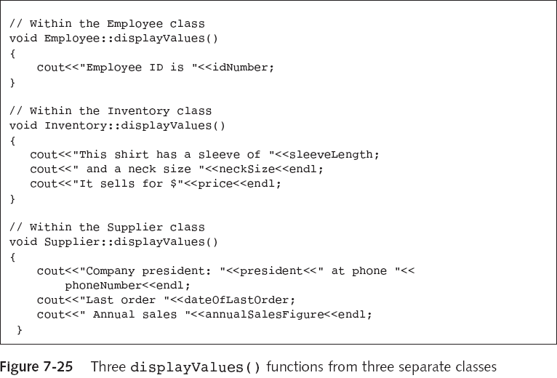
Understanding Polymorphism (continued)

Slide 29
You Do It: Creating and Using a Class
class CollegeCourse
{
private:
string department;
int courseNum;
int seats;
public:
void setDepartmentAndCourse(string, int);
void setSeats(int);
void displayCourseData();
};

Slide 30
Using a static Field
class Letter
{
private:
string title;
string recipient;
static int count;
public:
void setRecipient(string, string);
void displayGreeting();
static void displayCount();
};

Slide 31
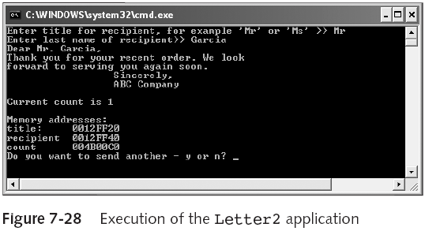
Understanding How static and Non-static Fields are Stored

Slide 32
Summary
A class is a category of objects
When you create a class, you hide, or encapsulate, the individual components
When you construct a class, you create the declaration section and the implementation section
When you create a class, usually you want to make data items private, and to make functions public
The scope resolution operator (::) identifies a member function as being in scope within a class

Slide 33
Summary (continued)
Each class object gets its own block of memory for its data members
You can access a static, class-wide field using a static function
One copy of each class member function is stored no matter how many objects exist
Within any member function, you can explicitly use the this pointer to access the object’s data fields
Polymorphism allows the same operation to be carried out differently depending on the object

